Slide 1
Supporting the Development of Children’s Counting
Notes:
Created by Megan Franke and Angela Chan Turrou
These slides are designed to engage students in making sense of the development of children’s ideas of counting and representation of their count and then in considering how they would support them. You can collect many of your own examples as well to enrich these.
We regularly use these slides after the students themselves have counted collections, discussed the mathematics that emerged, and begun to describe how children would count and represent their count.
This picture is from a 3 year old class in May.

Slide 2
Developing mathematical understanding within Counting Collections
Working on:
counting sequence
one to one correspondence
counting the full collection
cardinality
grouping
tens, hundreds, thousands (place value)
Notes:
Review of some of the counting ideas emerging in children’s thinking.
Highlight for participants that these ideas develop in relation to each other but not in this sequence. Children will develop partial understandings of each and in different orders. So a child can know part of the counting sequence and have one-to-one correspondence when counting to 6, or know much of the counting sequence and not yet have any understanding of one-to-one correspondence. Children do not “master” one and then move on to the next. Nor does a child develop all of these ideas up to 5 and then all of them up to 10. Rather children will develop some understandings to 10 before others up to 5.

Slide 3
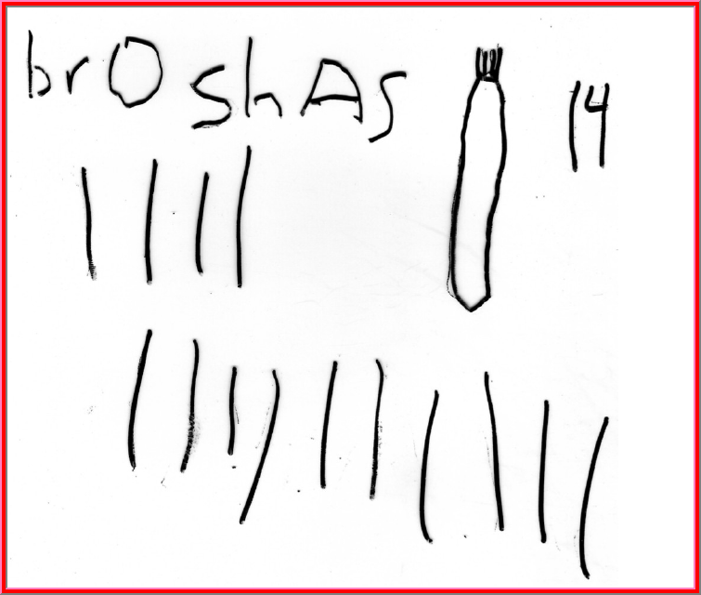
Notes:
What do you notice?
What might you ask?
What would you hope the student works on next?

Slide 4
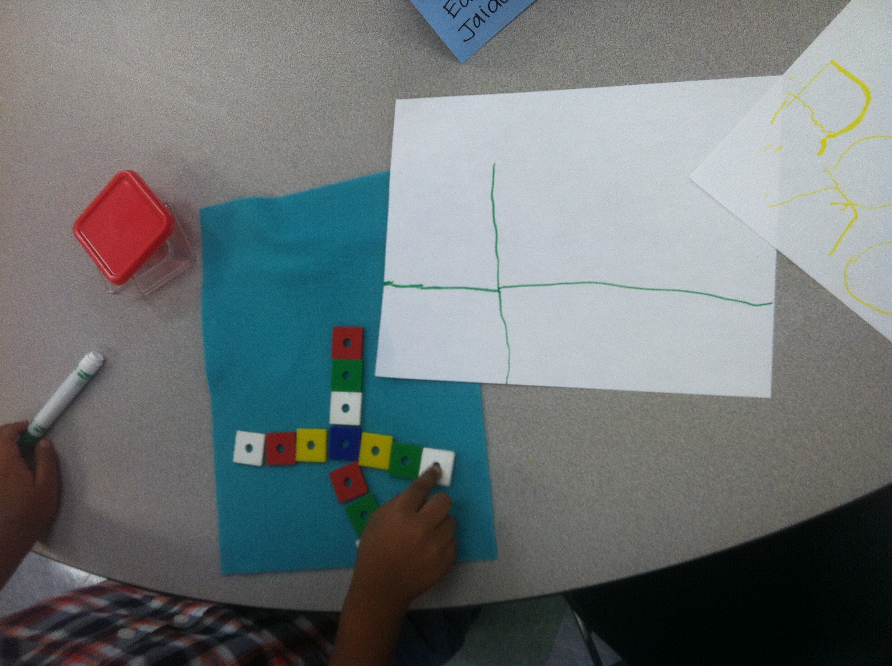
Notes:
Here is a child who has represented his collection by drawing the lines that show how he laid out the count. This example can be used to ask participants what they notice and what we might do to support this child to show the quantity in his collection on the paper. There are many options. One would be to ask him to describe what he did and ask how many he has on this part (pointing to a piece of the line). Another option is to ask if he can show on his paper where the red ones are. Or to ask if he can make a mark for each one.

Slide 5
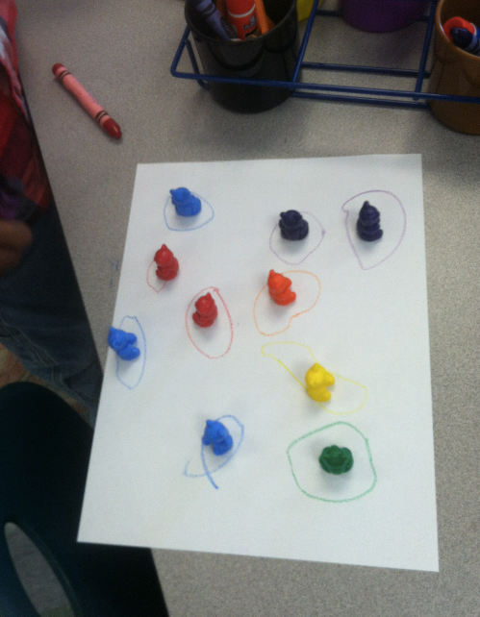
Notes:
Counts bears by putting them out on paper, represents by circling each bear with the same color crayon. Shows a circle for each bear. Ask participants what they know from this representation about the child’s number knowledge. (This does not show the child has one to one correspondence as we would have to her her count them. We also don’t know if she can count with the correct sequence or if she has cardinality.) What would you ask her?

Slide 6
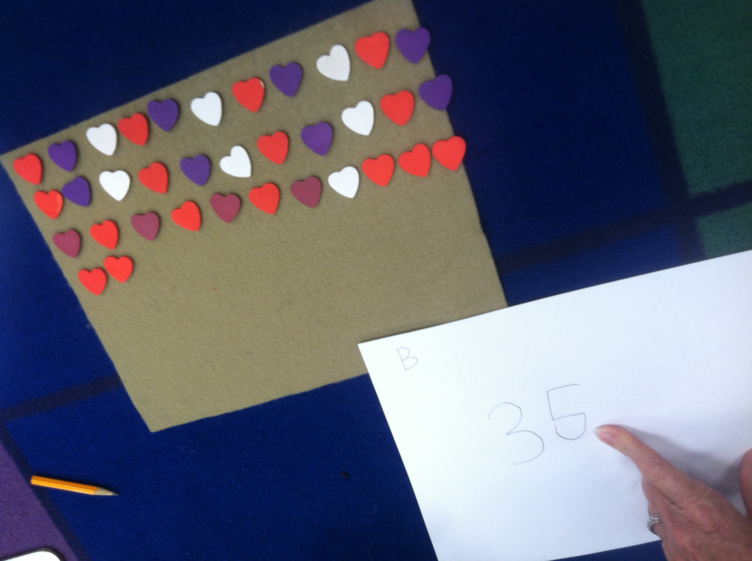
Notes:
Counts 35 hearts, writes numeral 35. organizes in long lines. Only shows the numeral 35 on her paper. What could you ask her or how could you support her to show her entire count on her paper?

Slide 7
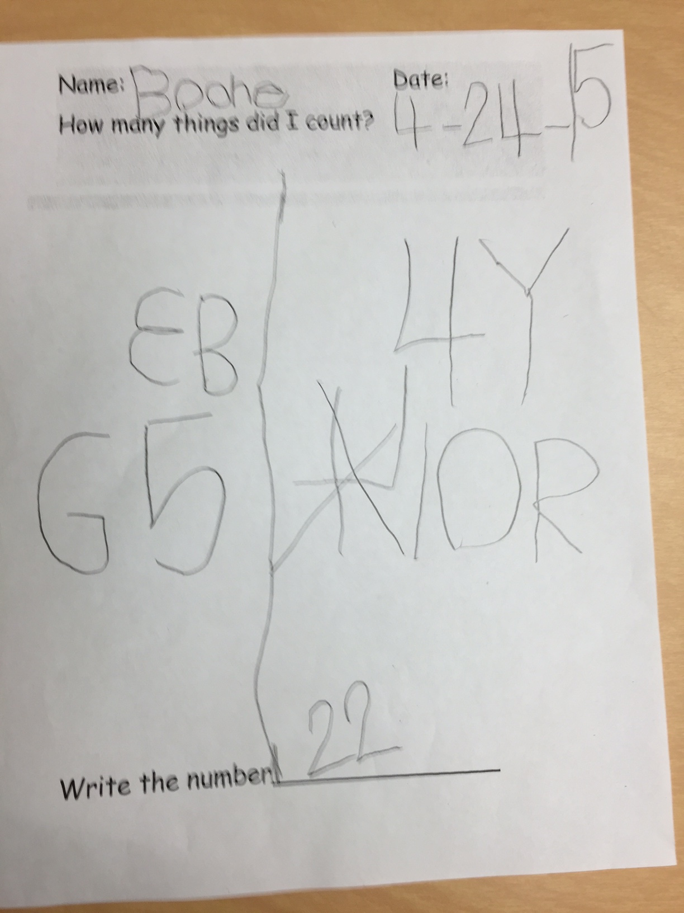
Notes:
This was the first time the child was asked whether he could organize his collection in some way. He sorted by color. He had 3 blue, 4 yellow, 5 green, 10 red and 22 altogether. So we can see that he can count 22. He can also organize in groups. He can count each color and label with a numeral. And we can see that he is most likely doing so accurately as his total matches his groups added together (he did not add these together – he got the 22 by counting them all).

Slide 8
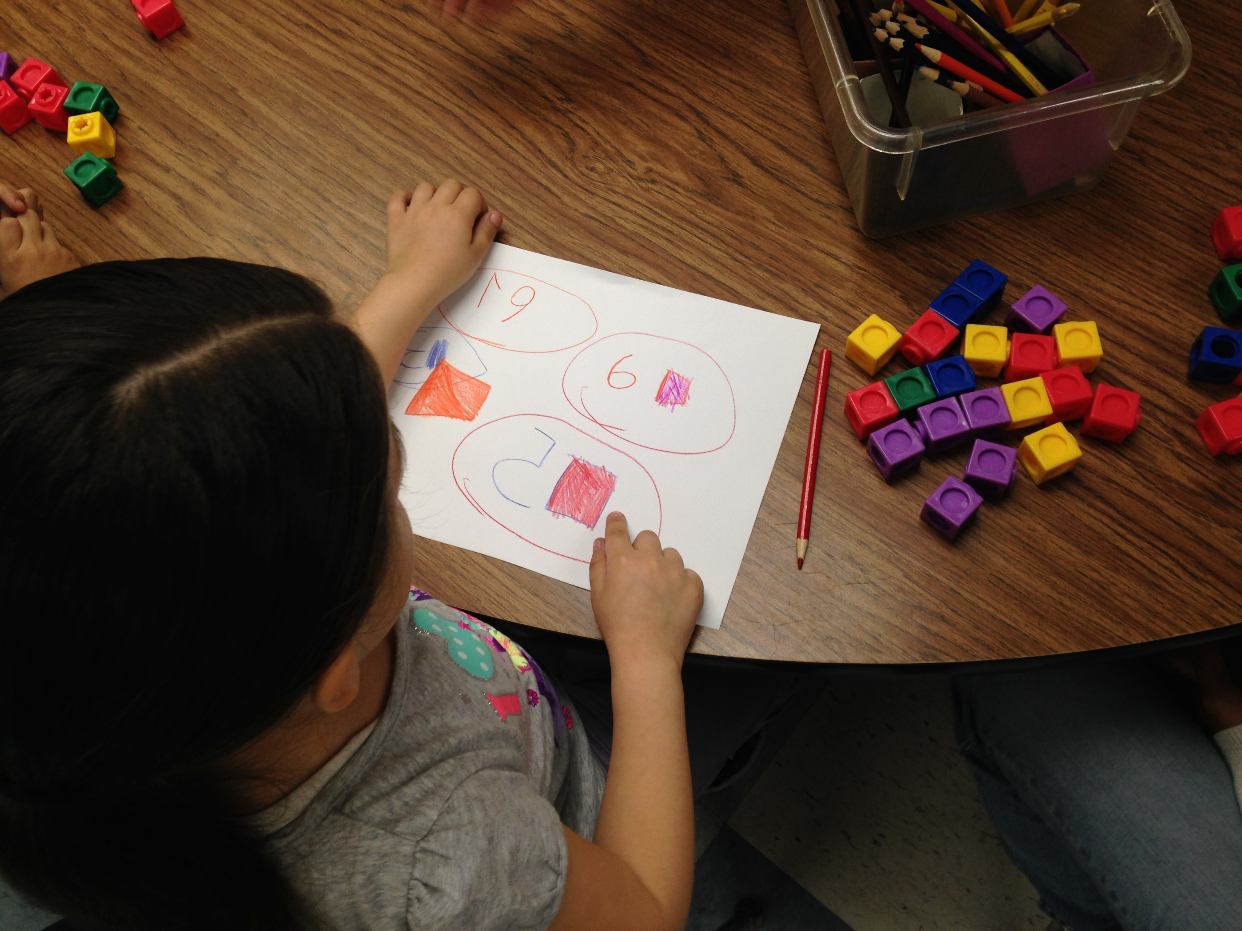
Notes:
Here we can see much the same as we saw in the previous slide. 6 purple, 5 red, 5 yellow, 3 blue – 19 together.

Slide 9
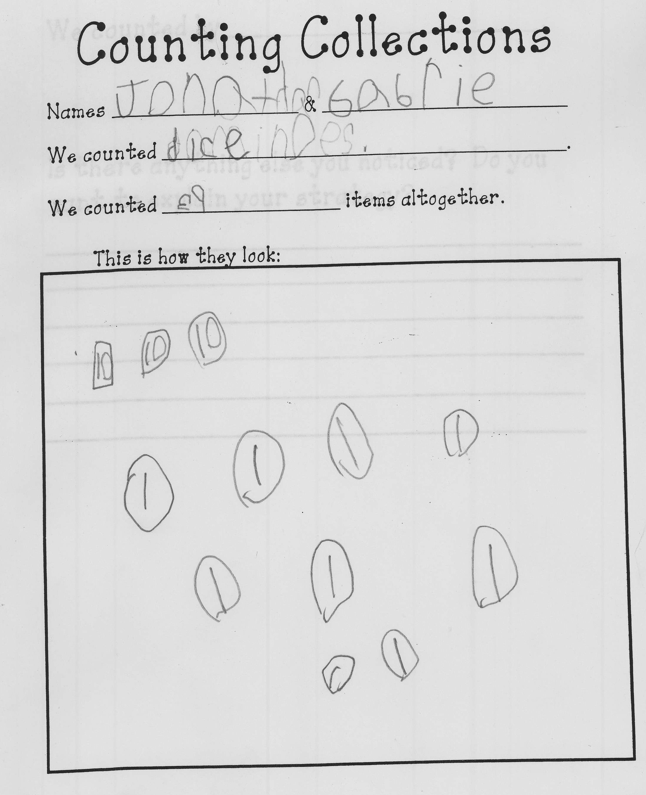
Notes:
What do you notice?
What might you ask?
What would you hope the student works on next?
Child counts dice. Counts 39. represents with 3 circles with 10s, and 9 ones. Groups by tens.

Slide 10
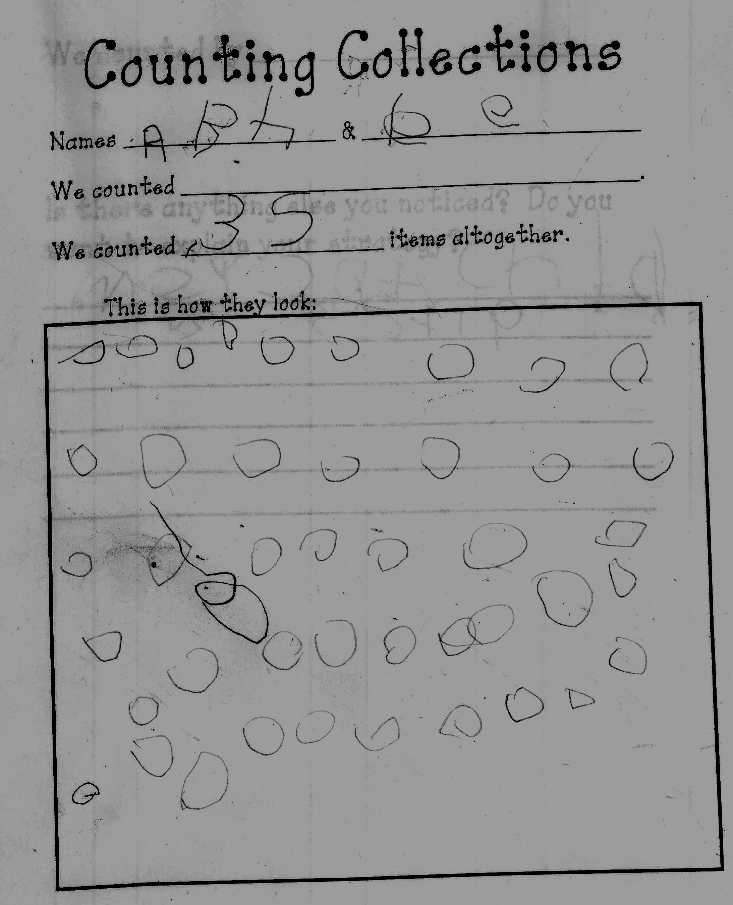
Notes:
Ones, how many? (44), Abe’s circles don’t match his #, although we do know Abe can write the numeral 35
What would you want to ask Abe?

Slide 11
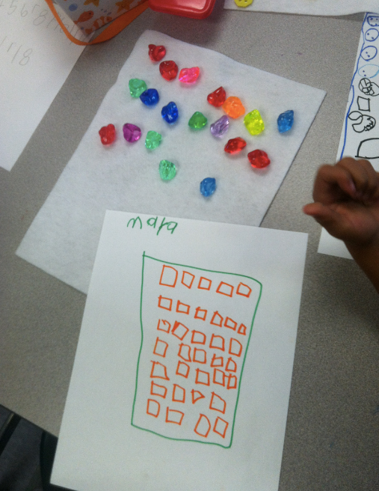
Notes:
This child does not have the same number of shapes on her paper as objects she counted. What might you ask? What might lead you to decide to let it go and not follow up until another day?

Slide 12
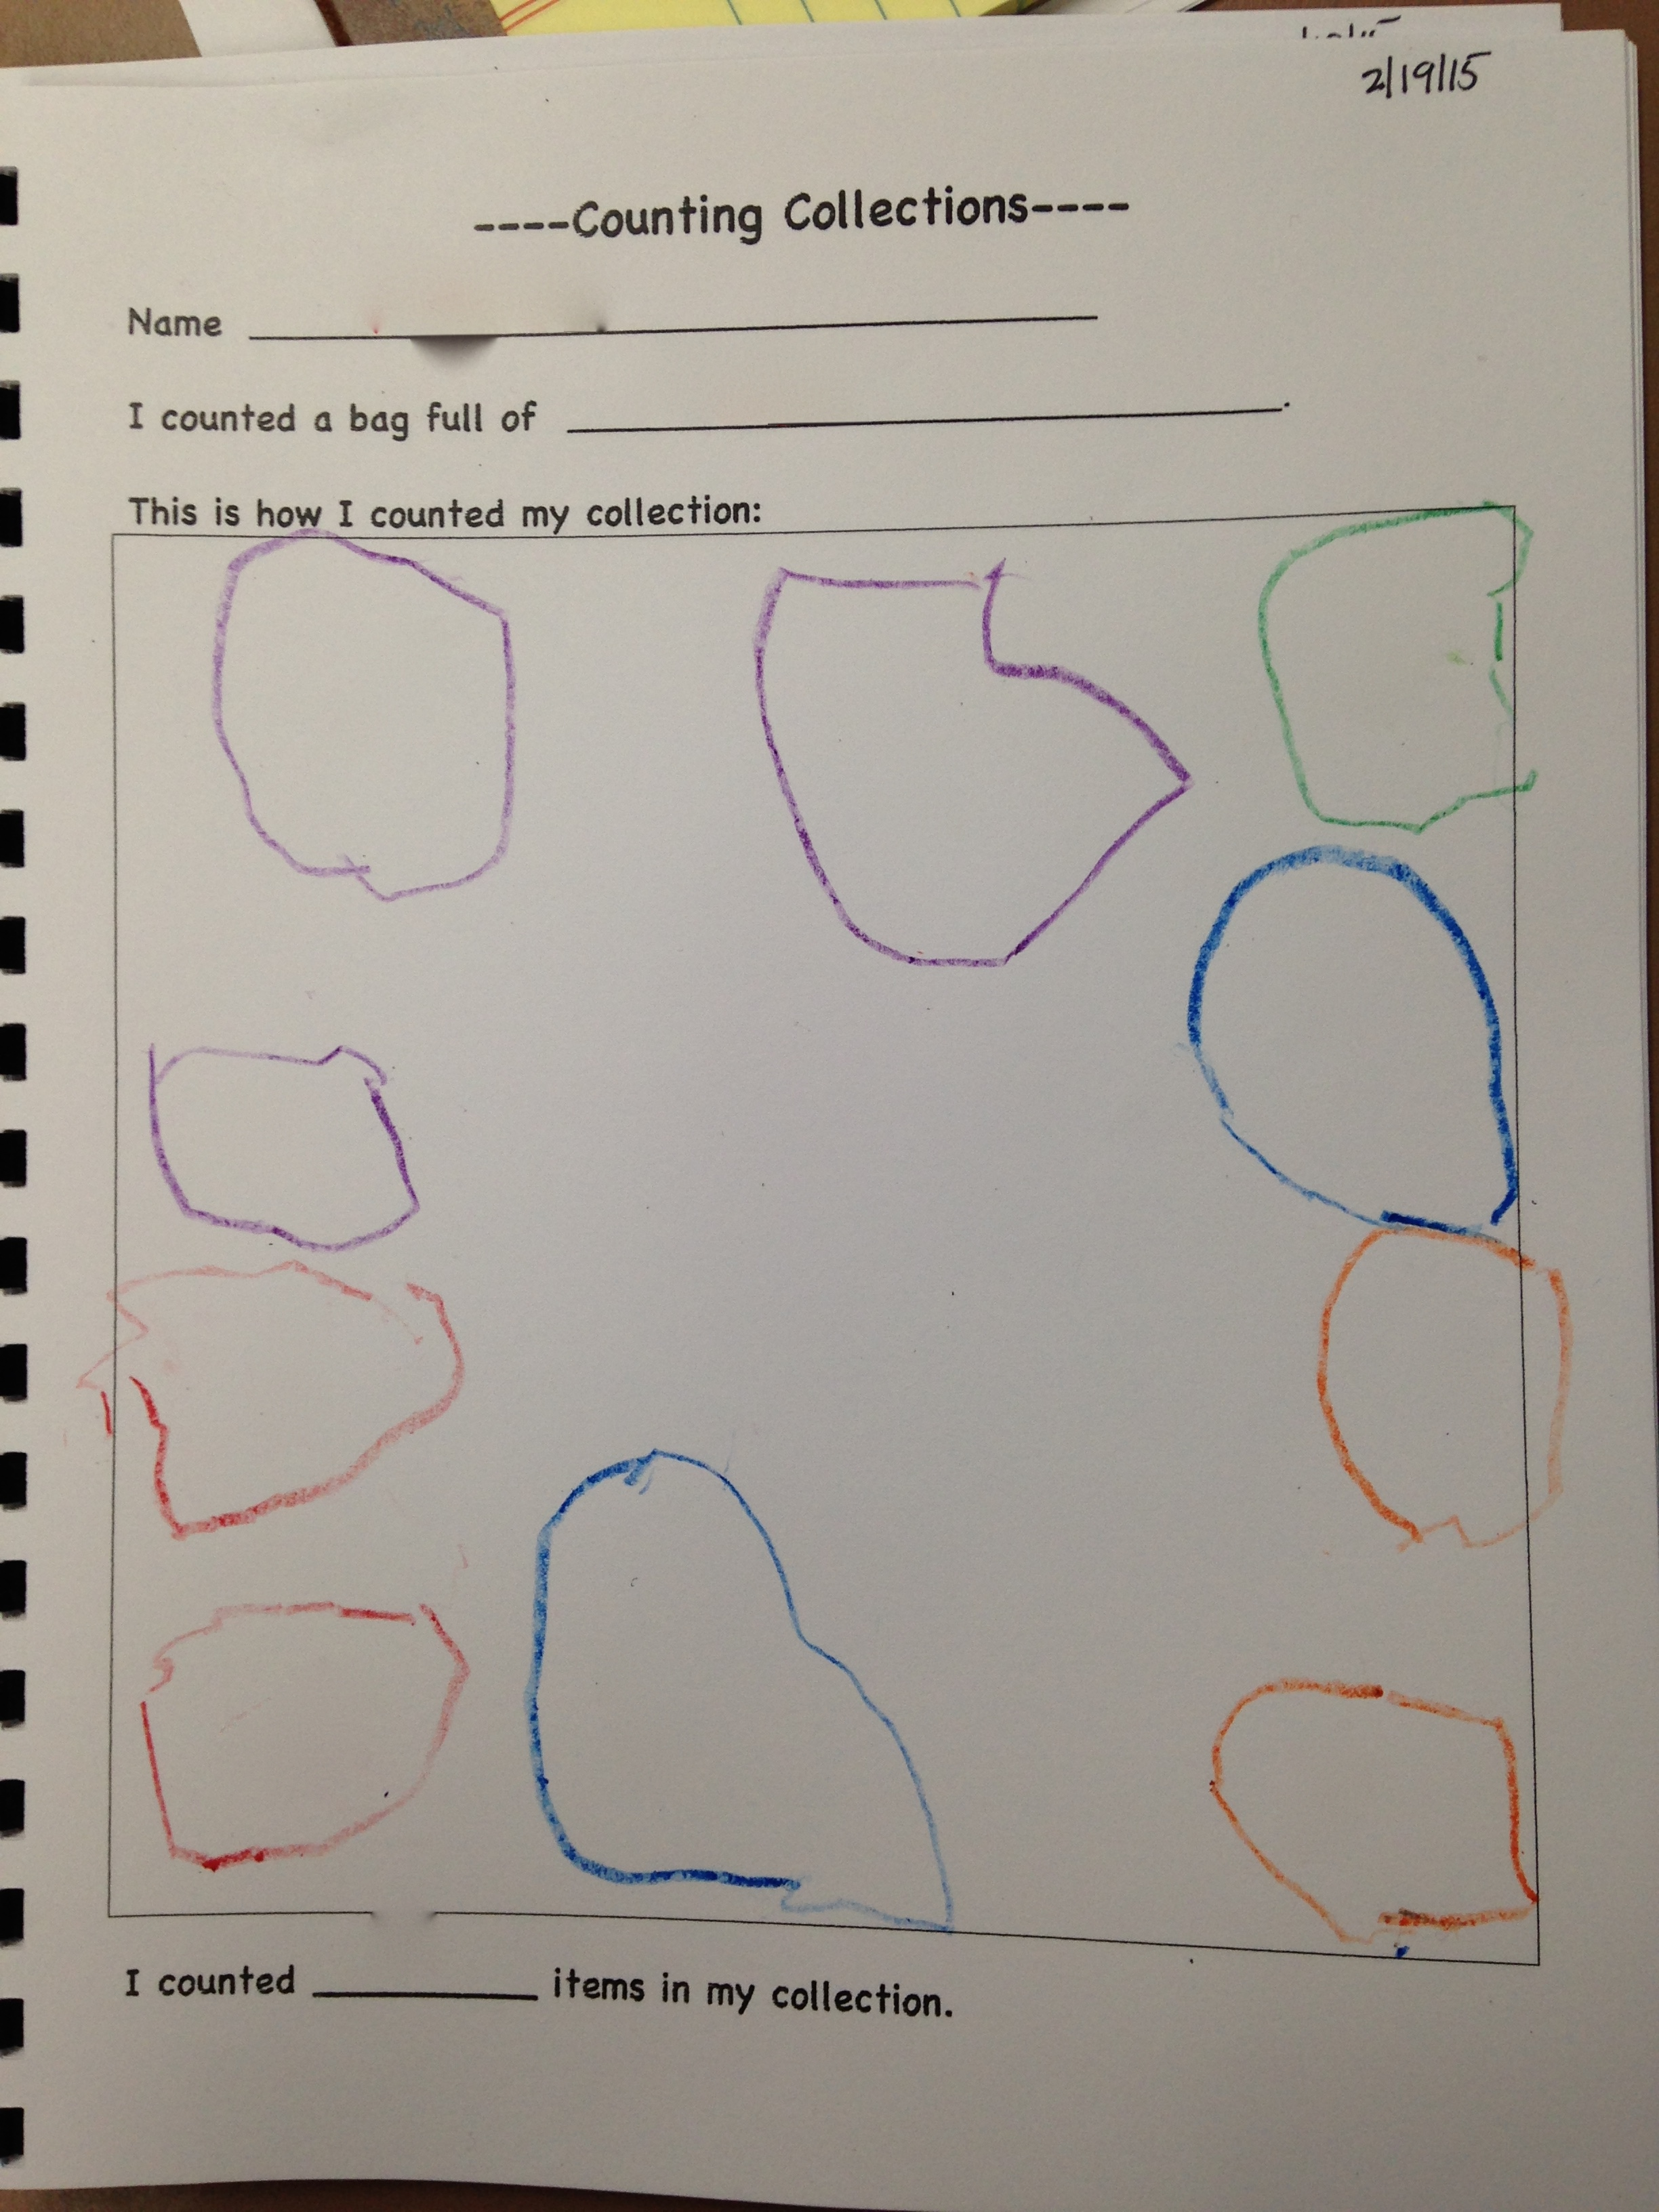
Notes:
What do we notice? Makes 10 circles. Looks like the child put he collection pieces all around the outside of the box and then circled each one. What do we want to find out? What would we ask? (see next slide)

Slide 13
Notes:
When the teacher asked how many in his collection – he answered 4. He had 10 in his collection. When she asked him to count them for her he counted as noted on the paper – the teacher wrote it down. Skipped 3 and 11. He demonstrated that he does know part (but not all) of the sequence, and has one to one correspondence, but does not show cardinality.

Slide 14
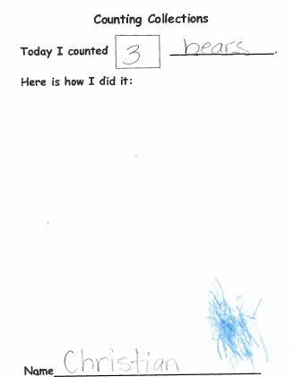
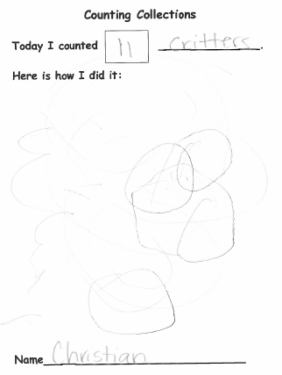
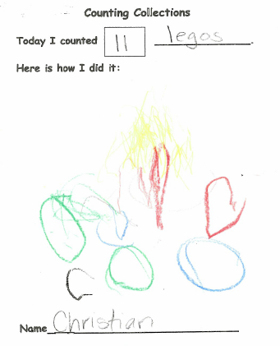
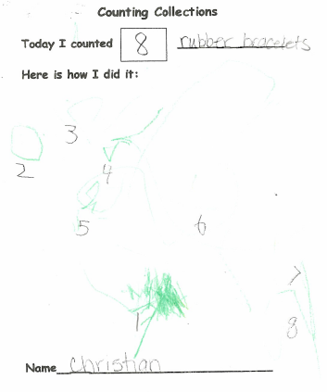
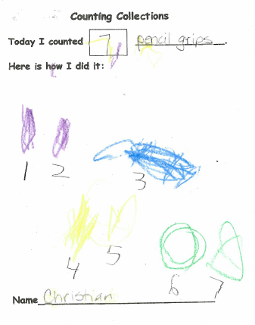
Notes:
This series of CC recording sheets were recorded by the same child during the second month of preschool. The numerals are the teacher’s notation as the child counted on five occasions over the course of a month.
What do you notice? About the quantity? About the child’s ability to represent each object only once, about her ability to represent the entire collection, about her progress?

Slide 15
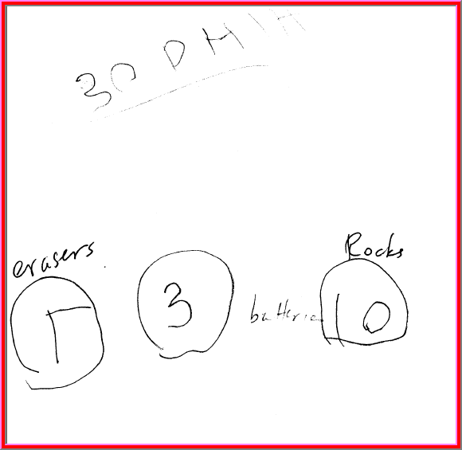
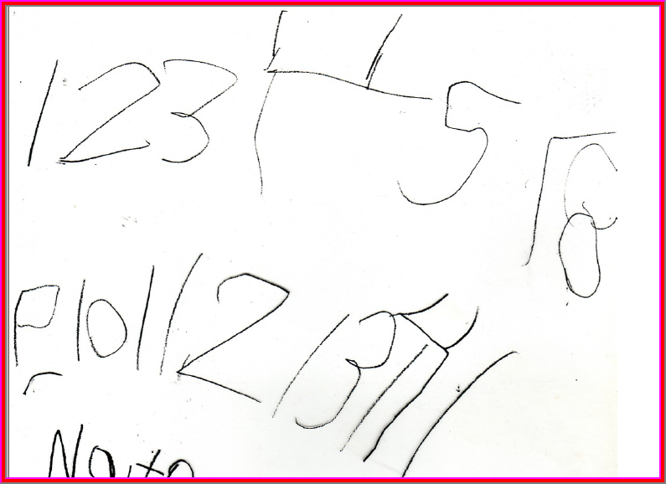
A
B
C
D
Notes:
How might your order these from least to most advanced in terms of what children know about counting? What are you looking for to decide?
There are many dimensions one my consider in deciding what makes one of these “advanced” mathematically.

