Slide 1
Math in the Classroom Workshop
February 2020 Vanessa Bailey
Notes:
Share where bathrooms are. Alert to break time/agenda. Make sure everybody has handouts and agenda as needed.
Were math and science anybody’s favorite subject in school?

Slide 2
Vanessa Bailey, MA
Advanced Transdisciplinary Infant Family Early Childhood Mental Health Practitioner
Regional Consultant Mentor
Child Development Professor vanessaba@cos.edu

Slide 3
Development & Research in Early Math Education
http://prek-math-te.stanford.edu/
Notes:
Show website.

Slide 4
Objectives
Develop math learning opportunities that are intentional, developmentally appropriate, engaging, and playful.
Create math opportunities designed to support children in achieving their individual learning goals.
Learn to use spontaneous opportunities that emerge through classroom or playground interactions as teachable math moments.
Notes:
The only DRDP cognitive (math) measure we are not going to go over is 6: patterning. There is an entire module on patterning on the website. We will be covering three modules today.

Slide 5
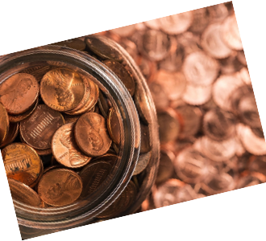
Introductions
Choose a penny
Find a partner who is not at the same table as you
Share something that was meaningful to you about the year that is on your penny
If you were not alive on the year that is on your penny, find someone you can trade with
After you’ve shared, tell your partner something you hope to gain from today’s workshop

Slide 6
Reflection
What understanding of math did you have to have to complete the activity we just did?
What concepts could be developed through the activity, if it were done with preschoolers?
Were any other domains of learning utilized through this experience?
How could you use this, or a similar activity (another coin, something else with numbers) in your classroom?

Slide 7
Operations
DRDP Measures COG 2, COG 3, COG 4, COG 5
Notes:
What do you think of when you hear “operations” as it relates to math?

Slide 8
Analyzing our thinking
Once you have finished, pair up and describe your methods of solving the problem with another person
Think about the underlying mathematical ideas that you had to utilize in order to be successful
Which operations did you use to come to your answer?
What does this tell us about operations?
Solve the problem in your head…
238+97
Notes:
10 Minutes – 9:40AM ENDING
Another suggestion is to ask participants at the end of the activity, “Why do you think I gave you this problem to do?” It is likely that they will discuss the importance of multiple solutions based on sensible mathematical ideas, and that they will recognize how hard it can be to describe one’s thinking and the ideas behind it.
A final suggestion is to ask participants about the implications of their problem-solving experience for helping young children to learn math. The hope is that participants will conclude that it is valuable to investigate children’s varied problem solving methods and the ideas behind them, and that they may be as surprised by children’s methods as they were by their peers’ and even their own.

Slide 9
Notes:
Child shows number sense of math operations. What is an activity you might typically do that would demonstrate this measure?

Slide 10
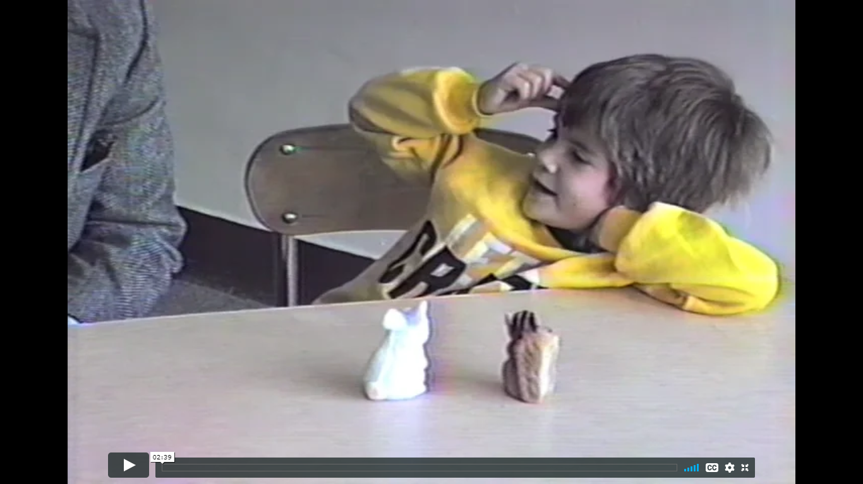
Analyzing Children’s Thinking
Notes:
http://prek-math-te.stanford.edu/operations/additional-operations-videos
Scroll down to Jennifer.
Pause video after she gets her initial answer.
What do we think she knows… what do we know about her thinking? Go BACK to DDRDP measure and answer where we may plot her based on her response. If you were testing or observing for DRDP measure, and you had stopped after her initial answer, without asking the question “how did you figure that out?” …. What would have happened?

Slide 11
Division in Preschool
Is this something you teach?
Is this something they learn?
Notes:
http://prek-math-te.stanford.edu/operations/additional-operations-videos

Slide 12
Notes:
Child shows developing understanding of number and quantity. What is an activity you might typically do that would demonstrate this measure?

Slide 13
Archie & Caro Scenario
Notes:
Use the teacher handout and the ELMO to review the case scenario and then pause the students at different points.
Discuss and reflect together.

Slide 15
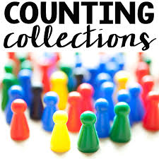
What could you do next to incorporate operations into this activity with your preschoolers?
Work in groups of 2 or 3 to count the collection of items that you have in front of you.
When you have finished counting, represent your work on the piece of paper you have in front of you.
Notes:
How do you think preschoolers would demonstrate or represent their work?
20 MINUTES

Slide 16
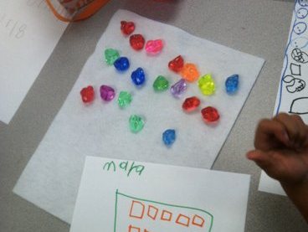
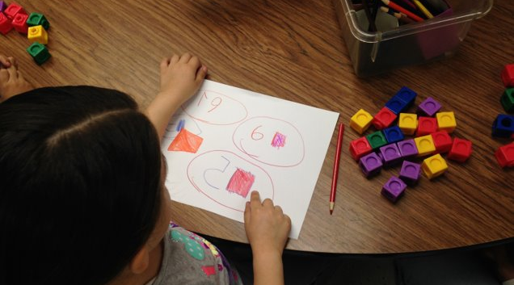
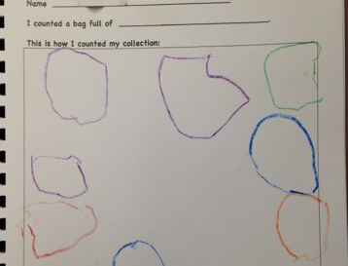

Slide 17
Operations in Practice
Video Example
Problem Type Handout
Notes:
http://prek-math-te.stanford.edu/operations/classroom-videos-operations
Scroll down to monkey bars video.
Which type of problem have you used?

Slide 18
Notes:
15 Minute Break – bathroom, snacks, stretch, etc.

Slide 19
Spatial Relations
DRDP Measures COG 1, COG 2, COG 7
Notes:
What do you think of when you hear “operations” as it relates to math?
COG 1 spatial relationships COG 2 CLASSIFICATION
COG 7 shapes

Slide 20
What is geometry?
Space
Shape
Notes:
What comes to mind when you think of geometry?
The convergence of space and shapes. How they work together, positioning of lines and shapes, how things fit, property of angles, etc.

Slide 21
Reflection
Make a list of all the geometry ideas you think children need to learn or can work on in preschool.

Slide 22
Classification & Identification
Notes:
http://prek-math-te.stanford.edu/spatial-relations/shape-assessment-videos
Laura Jane: Sort Shapes… show video.

Slide 23
Article Handout
Notes:
Review together and discuss with partner some ideas you use in your classroom for geometry.
5-10 minutes.

Slide 24
Map Making Activity
Notes:
http://prek-math-te.stanford.edu/spatial-relations/additional-spatial-relations-videos
Show the first five minutes.
Discuss what the participants noticed about the child’s knowledge of spatial relations. What other school activities might support this spatial relations work?

Slide 25
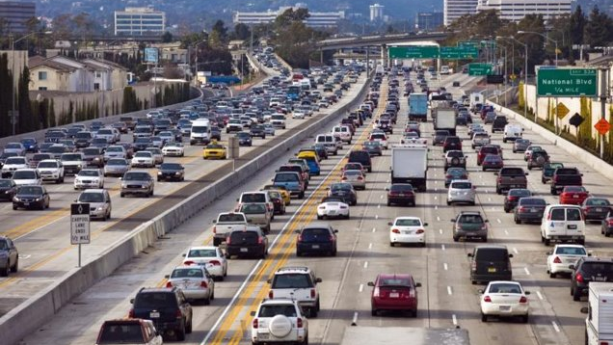
Notes:
Describe what you see here….

Slide 27
Describe, Draw, Describe
A lesson in geometry
Notes:
Read the book. Stop on a page and tell them to draw what they see. Expect a large range of responses.

Slide 28
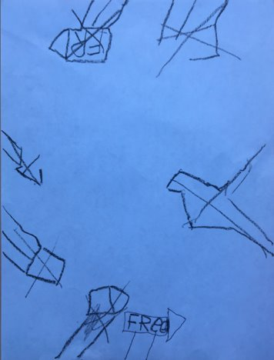

Slide 29
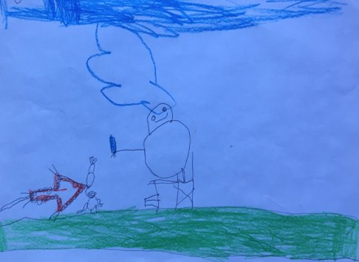
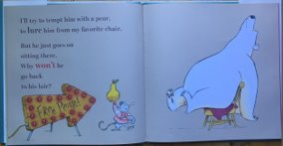

Slide 30
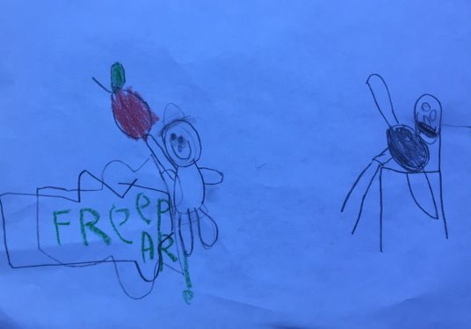

Slide 32
Thinking About Thinking
Notes:
Reflect: does she have it right or wrong? How do you know? What mathematical understanding, geometry or other math principles can be learned and understood by this exercise?
http://prek-math-te.stanford.edu/spatial-relations/betsy-and-three-mathematical-bears

Slide 33
Measurement & Data
COG 5

Slide 34
The Mathematics of Data
Classifying & Sorting
Comparing
Counting
Measuring
Representation of Data
Origin
Unit Size
Notes:
Think about these for a moment and chat with a neighbor. Which do you frequently cover in your classroom? Are there any you don’t really address? Which do you feel confident in? Which are you less confident in?

Slide 35
Erica & Graphing
Notes:
http://prek-math-te.stanford.edu/measurement-data/data-assessment-videos#erica_read_picture_graph
Use handout to evaluate what understanding of data Erica may have or not have/be missing.

Slide 37
I’m the Greatest
You will be assigned an item number.
Think about the item you’ve been assigned in relation to the others pictured and make a case for why yours is the “greatest” of the four
Find a person who has another item, and debate your case to them, as they will also think their item is greater!
Find a person who had the same item, and see if their reason for being “greatest” was the same as yours
1 Water Bottle | 2 Foil Pan | 3 Storage Container | 4 Ice Pack
Notes:
10 Minutes
Meet back as a whole group to discuss what participants learned from the activity. Below are some possible discussion questions that can be used to follow up after the activity:
What did you think of this activity? Why do you think I presented it to you?
Did anything surprise you? (Some participants might say that they had not considered having young children think about capacities or weights, not just lengths, when teaching about measurement.)
Was it easier to make a case for some objects than others? (For example, the taller object is visibly taller than the others, yet one would have to pour sand or liquid into it to prove that the food storage container had the greatest capacity.)
Do you think an activity like this could be used in an early childhood classroom?
Which attribute(s) would you expect a young child to pay the most attention to? (Participants may point out that many children may be most interested in the attribute of height, because that is a very important attribute about the children themselves.)
Do you think young children would struggle to understand that one object can be both the greatest and the least? (For example, the water bottle has the greatest height but also has the least width of any of the objects. The pie pan has the greatest width, but the least height.)
Could there be an object that could be greatest in either of two ways depending on how you orient it? (In other words, something is tall if held up and wide if placed horizontally?) How do you think a young child would deal with that?
Can you think of other ways to modify this task? (For example, would you consider providing an object that is "the greatest" in more than one way at once, such as the tallest and also the heaviest?)
Ask the participants to revisit the activity after the session by reflecting on their experiences in writing. Use their responses to shape your own teaching.

Slide 38
Measure Something
Measure an item near you. Utilize whatever materials you can find to measure with.
Notes:
Discuss standard vs. nonstandard units of measurement. Compare them.

Slide 39
Standard vs. Nonstandard Measurement
Notes:
2nd video 1:33 seconds.
Reflect on this video… what does she know. What does she not know. What is the disconnect. Why can’t she figure out the nonstandard unit of measurement? What IS she using to measure the sticks?

Slide 40
What DOES Bella know?
Notes:
http://prek-math-te.stanford.edu/measurement-data/bella-and-cubes-measurement-mystery
Final video at the end…
When asked, "So, which is longer, the blue or the orange?" Bella places all of the sticks and stacks of cubes together and says, "This one," pointing at the stack of 10 cubes, not at the blue stick. She says she knows this because "I measured it and this one [the stack of 10] is taller." She seemed to be comparing overall lengths, which in this case is easy to do without counting. Then, when asked if she could look at the number of cubes to compare them, she treats them as quantities, saying 10 cubes is longer than six cubes because the count sequence "one, two, three, four, five, six, seven, eight, nine, ten" is longer than "one, two, three, four, five, six." So she is able to count and understand quantities, but does not appear to use them in comparing the lengths.
Bella’s thinking about measuring the sticks still remains a mystery. But the interviewer uncovered some of her thinking. She can see the difference between the cube stacks. She can determine the number of cubes in each stack and knows which number is higher by referring to the relative length of the counting word sequence. But she does not use the cubes as units of measurement for the length of the sticks.

Slide 41
Classifying
Notes:
http://prek-math-te.stanford.edu/measurement-data/data-assessment-videos
Danielle: Categorize & Sort
How can this activity be connected back to data & measurement? What later developing math skill would this activity support?

Slide 42
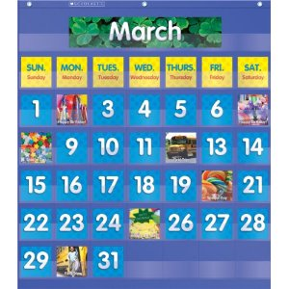
To Calendar or Not to Calendar… ?
Notes:
Read and discuss vignette together… (if time). Send article as homework if not time to discuss together.

Slide 43
Closing Story

Slide 44
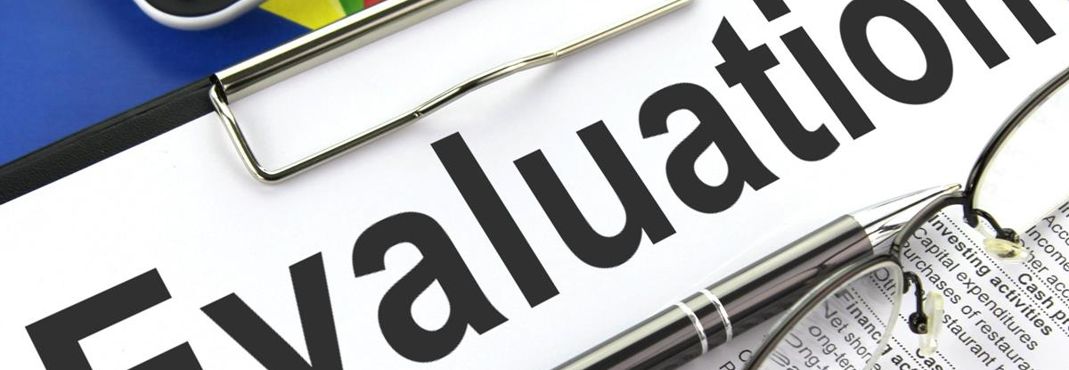
This Photo by Unknown Author is licensed under CC BY-SA
Thank you for coming!

